Slide 1
PyTorch Training Tutorial

Slide 2
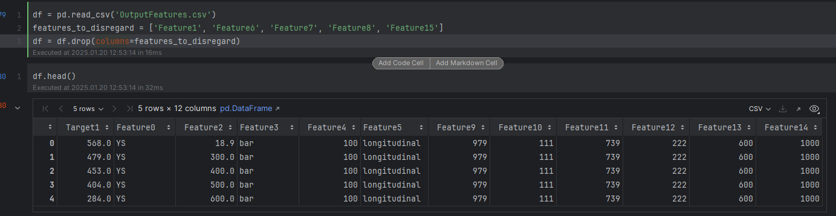
Dataset Preprocessing Explanation
Load the Dataset:
pd.read_csv('OutputFeatures.csv'): Reads the CSV file into a DataFrame.
Identify Features to Remove:
Create a list of constant features, e.g., ['Feature1', 'Feature7', 'Feature8', 'Feature15'], which remain unchanged across samples.
Remove Irrelevant Features:
df.drop(columns=features_to_disregard): Drops columns that don't vary, ensuring the dataset only contains relevant information.
Preview the Cleaned Dataset:
Use df.head() to verify the changes.
Why Remove Constant Features?
These features add no value for modeling or analysis as they lack variability.

Slide 3
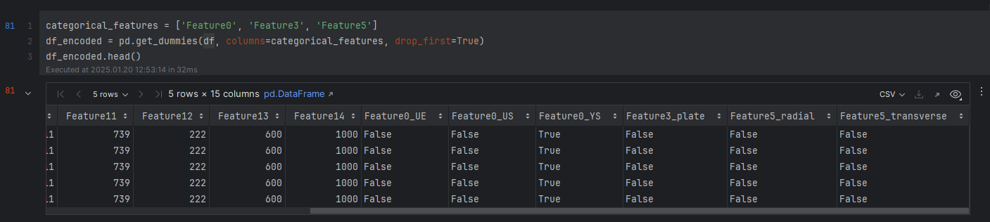
Encoding Categorical Features
Identify Categorical Features:
A list of categorical features is created: ['Feature0', 'Feature3', 'Feature5'].
Apply One-Hot Encoding:
pd.get_dummies(df, columns=categorical_features, drop_first=True):
Converts categorical features into binary columns.
drop_first=True removes one column per category to avoid multicollinearity.
Result:
The original categorical columns are replaced with new binary columns representing
Prepares categorical data for machine learning models by converting text labels into a numerical format.

Slide 4
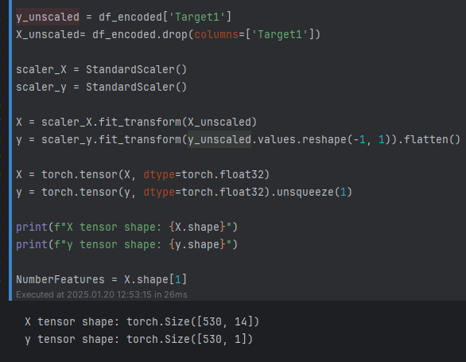
Data Scaling and Tensor Conversion
Separate Features and Target:
y_unscaled: Extracts the target variable ('Target1') from the DataFrame.
X_unscaled: Retains the feature variables by dropping 'Target1'.
Apply Standard Scaling:
StandardScaler() is used to scale the data:
X: Features are scaled using scaler_X.
y: Target variable is scaled using scaler_y.
Convert to PyTorch Tensors:
Convert scaled features (X) and target (y) into PyTorch tensors:
X: Feature tensor of type torch.float32.
y: Target tensor reshaped to include an additional dimension.
Shape of Tensors:
X tensor shape: (530, 14) – 530 samples, 14 features.
y tensor shape: (530, 1) – 530 samples, 1 target value.
Purpose:
Standardization ensures consistency for model training.
Conversion to tensors prepares the data for deep learning frameworks like PyTorch.

Slide 5
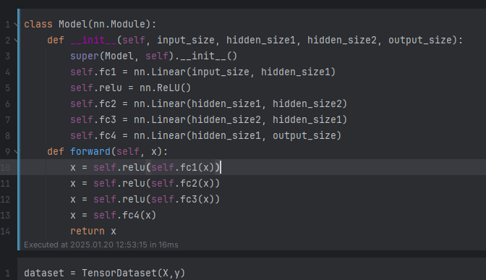
Neural Network Model Definition
Define a Custom Model Class:
The class Model inherits from nn.Module, a base class for all PyTorch models.
Model Initialization (__init__):
Layers are defined in the constructor:
fc1: Fully connected layer from input_size to hidden_size1.
fc2: Fully connected layer from hidden_size1 to hidden_size2.
fc3: Fully connected layer from hidden_size2 back to hidden_size1.
fc4: Fully connected layer from hidden_size1 to output_size.
ReLU: Activation function used between layers to introduce non-linearity.
Forward Pass (forward):
Defines how the input data flows through the model:
Input passes through fc1 → ReLU.
Passes through fc2 → ReLU.
Passes through fc3 → ReLU.
Final output computed with fc4.
Purpose:
This architecture represents a feedforward neural network with two hidden layers and ReLU activations, ideal for tasks like regression.
Flexible Design:
Accepts parameters (input_size, hidden_size1, hidden_size2, output_size) for easy customization based on the dataset.

Slide 6
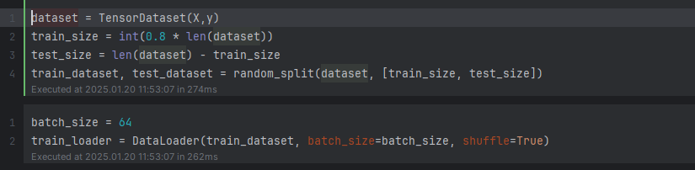
Dataset Preparation and DataLoader Setup
Combine Features and Target:
TensorDataset(X, y): Combines the feature tensor X and target tensor y into a single dataset object for PyTorch.
Split Dataset into Train and Test Sets:
train_size, test_size : 80% of the dataset is used for training. The remaining 20% is for testing.
random_split: Splits the dataset into train_dataset and test_dataset based on the specified sizes.
Define Batch Size:
batch_size = 64: Specifies the number of samples per batch for training.
Create DataLoader for Training:
DataLoader(train_dataset, batch_size=batch_size, shuffle=True):
Loads data in batches for training.
Shuffles the data at each epoch to improve training performance.
Purpose:
Efficiently handles dataset splitting and batch processing for model training and testing.

Slide 7
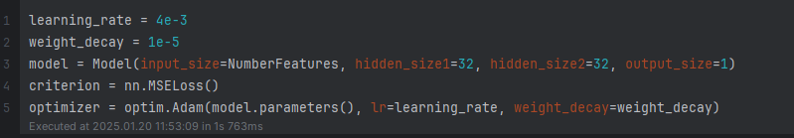
Model Initialization and Optimization Setup
Set Hyperparameters:
Learning Rate (lr = 4e-3):
Determines the step size for updating model weights during optimization.
A high learning rate may cause overshooting and instability, while a low learning rate may result in slow convergence.
Weight Decay (wd = 1e-5):
A regularization technique that adds a penalty proportional to the size of the weights.
Helps prevent overfitting by encouraging smaller, more generalizable weights.
Initialize the Model:
Model: A neural network wit
input_size = NumberFeatures: Number of input features.
Two hidden layers, each with 32 neurons (hidden_size1=32, hidden_size2=32).
output_size = 1: Single-value output for regression.
Loss Function:
criterion = nn.MSELoss(): Mean Squared Error between predictions and actual values.
Optimizer - Adam:
Adam (Adaptive Moment Estimation):
Combines momentum (smooths gradients over time) and adaptive learning rate (adjusts the step size for each parameter).
lr=learning_rate: Controls the magnitude of weight updates.
weight_decay=weight_decay: Adds regularization by penalizing large weights.
Purpose:
Learning rate ensures efficient learning speed.
Weight decay prevents overfitting, improving model generalization.
Adam optimizer combines these elements for effective and stable training.

Slide 8
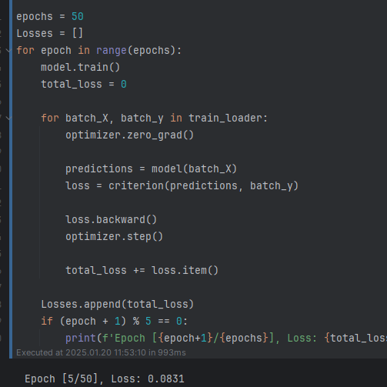
Training Loop for the Neural Network
1. Epoch Loop:
Repeats the training process for a specified number of epochs.
model.train(): Sets the model to training mode
2. Batch Processing:
For each batch of data (batch_X, batch_y) from the train_loader:
optimizer.zero_grad(): Clears gradients from the previous iteration to prevent accumulation.
predictions = model(batch_X): Computes predictions for the batch using the model.
loss = criterion(predictions, batch_y): Calculates the loss for the batch using the specified loss function.
loss.backward(): Computes gradients for all model parameters using backpropagation.
optimizer.step(): Updates the model parameters based on gradients and optimizer settings.
3. Track and Log Loss:
total_loss += loss.item(): Accumulates the total loss for the epoch.
Append the total_loss to the Losses list for analysis.
Print progress every 5 epochs:
4.Purpose:
This loop trains the model by iteratively adjusting weights to minimize the loss function.
Tracks and monitors the training process to ensure convergence.

Slide 9
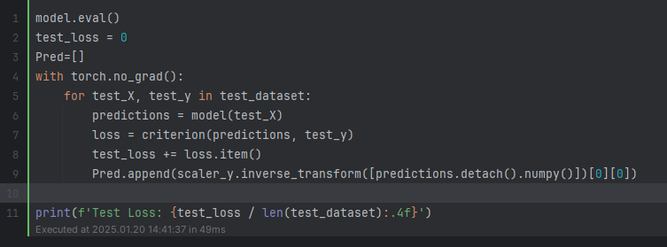
Model Evaluation on Test Data
Switch to Evaluation Mode:
model.eval(): Sets the model to evaluation mode, disabling training-specific layers like dropout.
2.Evaluation Loop:
torch.no_grad(): Disables gradient calculation to save memory and speed up evaluation.
Iterate through test_dataset:
predictions = model(test_X): Compute predictions for the test samples.
loss = criterion(predictions, test_y): Calculate loss using the test predictions and true labels.
test_loss += loss.item(): Accumulate the total loss for all test samples.
Append the inverse-transformed predictions (back to original scale) to the Pred list.
3.Log Test Loss:
Calculate and print the average loss:
test_loss / len(test_dataset) provides the average loss per sample.
4.Purpose:
Evaluate the model’s performance on unseen data (test set).
Record predictions for further analysis and comparison with true labels.

